Slide 1
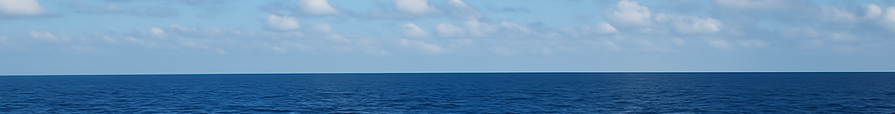


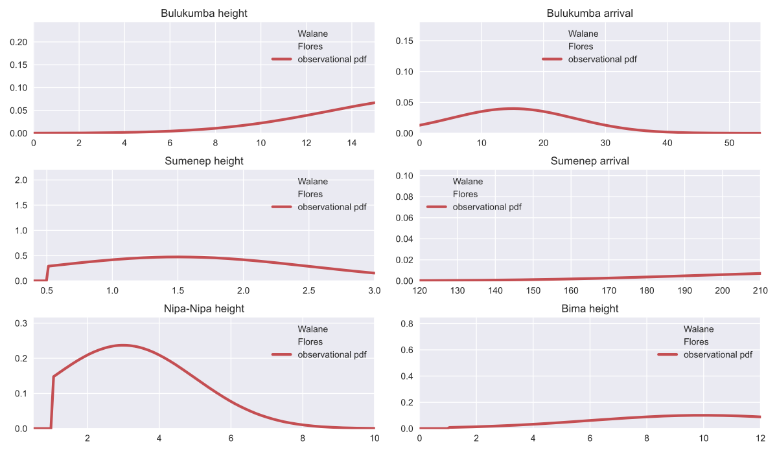
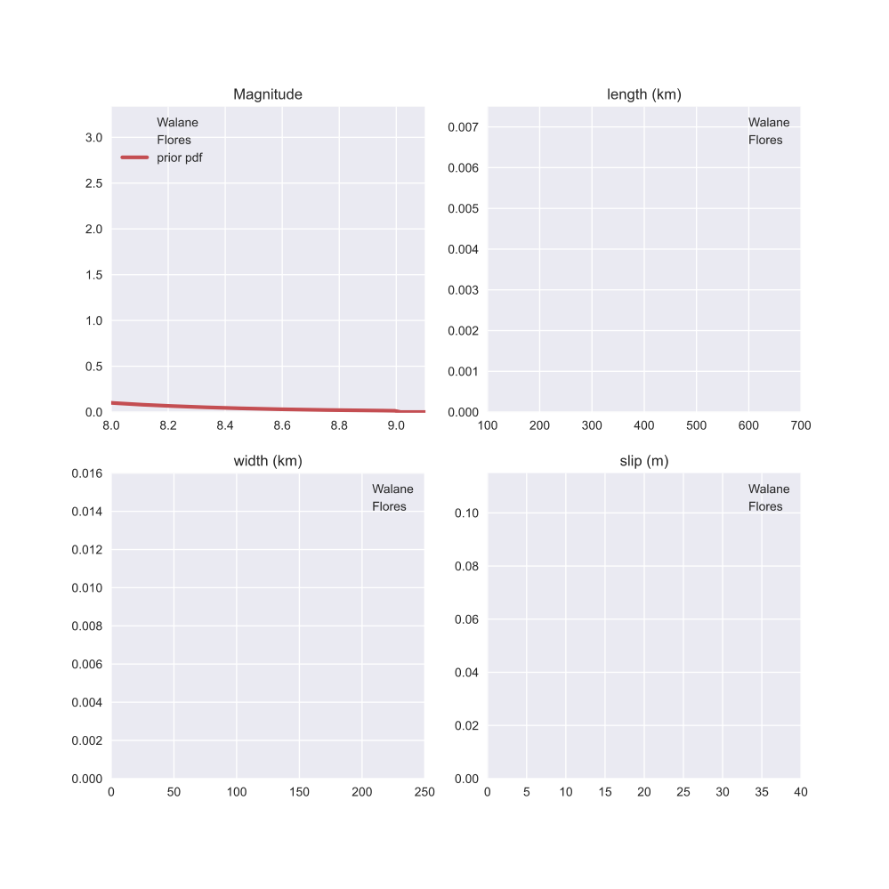
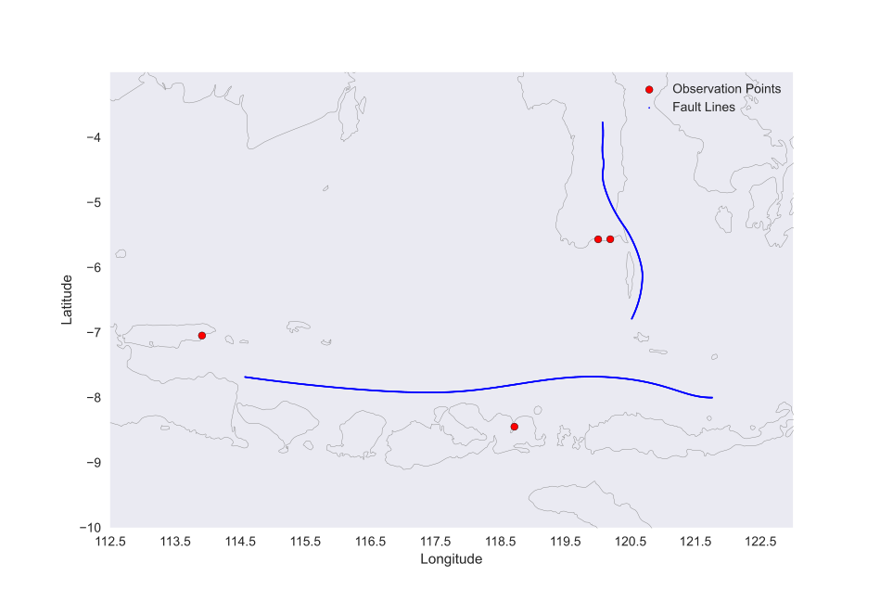
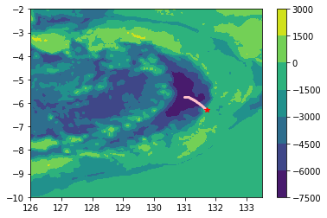
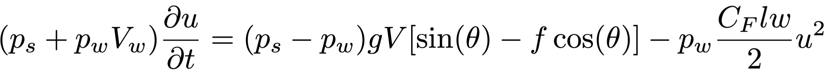
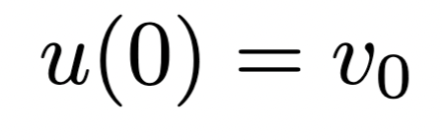
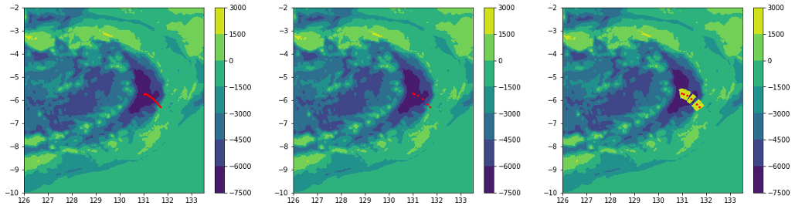
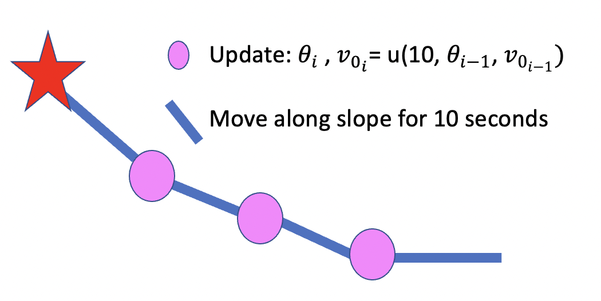
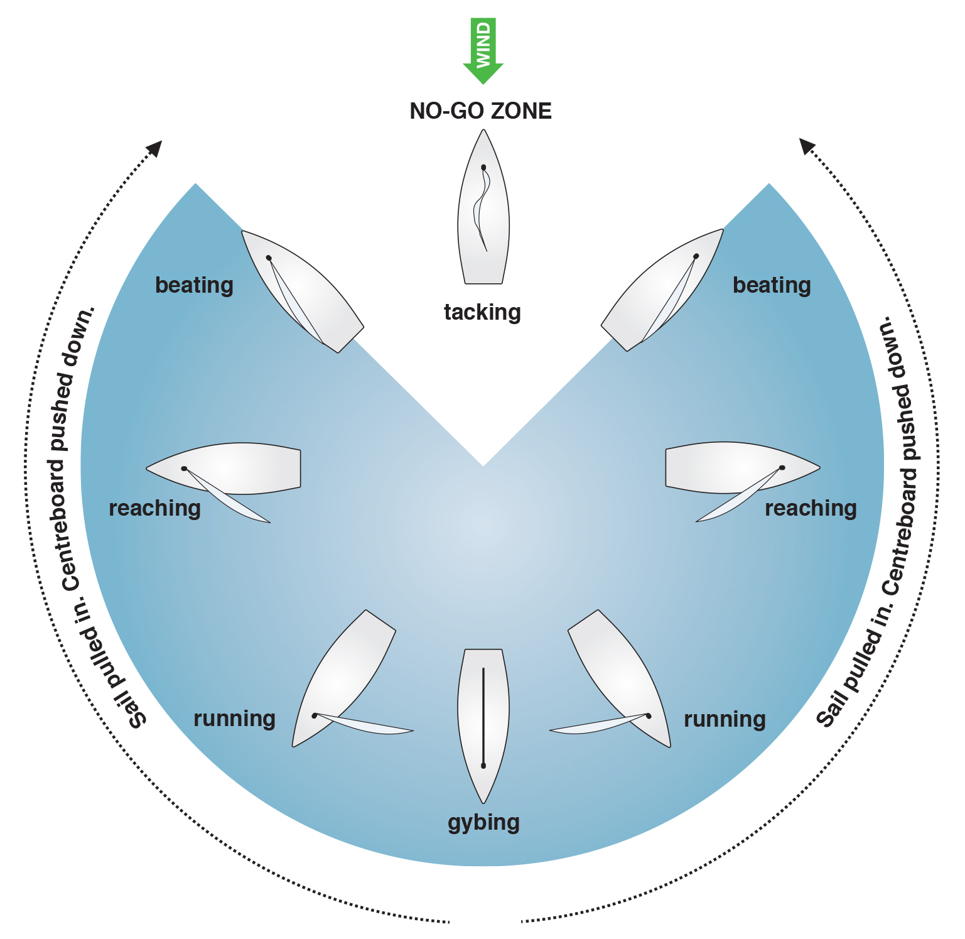
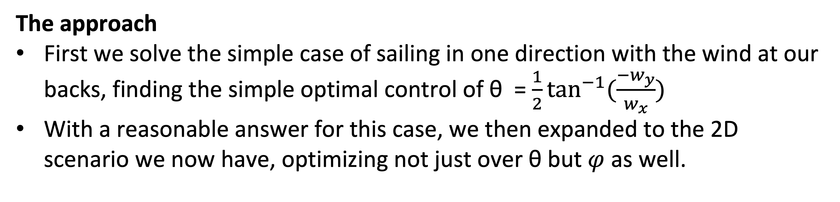
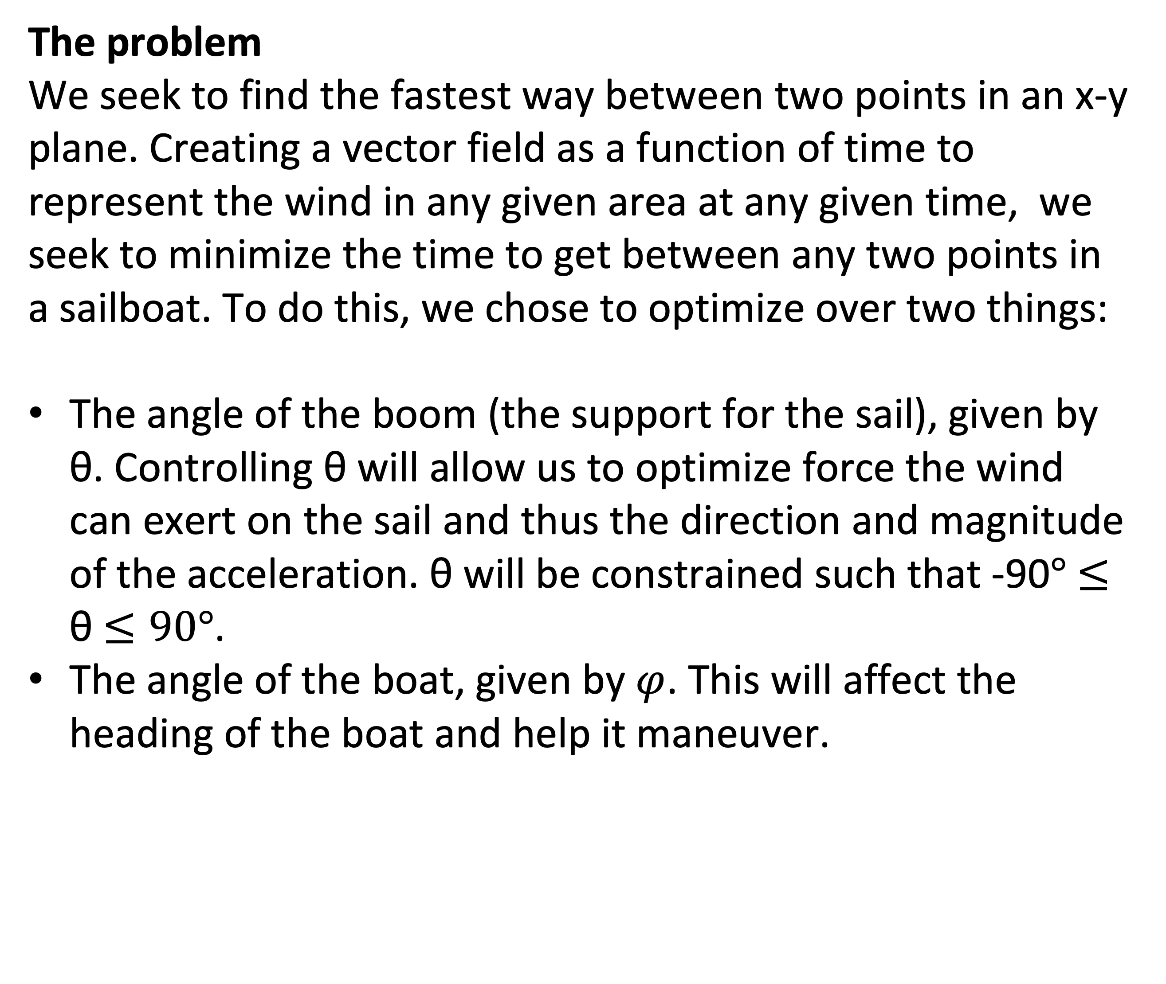
A catchy, very cool title
Charting Uncharted Waters
Names of all the important people who contributed, i.e. everyone in the group. The QR code can be used to link to a GitHub repo, animation, pdf copy of details etc..
An Optimal Control Story
Dallin Anderson, Joseph Du Toit, Abraham Harris, Nephi Suyama, Ryan Wood
Overview Sailing is an art and tool that has been used by mankind for millennia. While experienced sailors likely know the most efficient and fastest way to sail from point A to point B given certain wind conditions, we take on the problem of using optimal control to find the best way to get from point A to point B.
Describe what progress you made
What did you manage to do? You are allowed to report on mistakes and/or steps you took that did not pan out as well as on those that worked out well.
Optimal control theory is a powerful framework used in engineering, economics, and various other fields to design control strategies that optimize the performance of a system while adhering to specified constraints. At its core, optimal control seeks to find the control inputs that minimize or maximize an objective function, often representing a cost or utility associated with the system's behavior over time.
In engineering applications, optimal control plays a crucial role in designing efficient and robust control systems for complex dynamical systems. Whether it's guiding a spacecraft to its destination with minimal fuel consumption, stabilizing an aircraft during flight, or regulating the operation of industrial processes, optimal control techniques provide a systematic approach to achieving desired performance objectives while accounting for constraints such as energy limitations, safety requirements, and environmental considerations.
Figure 3: The layout here is just a suggestion. You can modify the figure placement, adjust the spacing etc.. The important thing is really to use a lot of figures.
In engineering applications, optimal control plays a crucial role in designing efficient and robust control systems for complex dynamical systems. Whether it's guiding a spacecraft to its destination with minimal fuel consumption, stabilizing an aircraft during flight, or regulating the operation of industrial processes, optimal control techniques provide a systematic approach to achieving desired performance objectives while accounting for constraints such as energy limitations, safety requirements, and environmental considerations.
In economics, optimal control is employed to study decision-making processes in dynamic systems, such as resource allocation, investment strategies, and policy design. By formulating mathematical models that represent the dynamics of economic systems and the objectives of decision-makers, economists can use optimal control theory to identify optimal policies that maximize social welfare, economic growth, or other desirable outcomes, taking into account factors like resource constraints, uncertainty, and competing objectives.
Overall, optimal control theory provides a rigorous framework for addressing a wide range of optimization problems in dynamic systems, offering insights and methodologies that are indispensable for tackling real-world challenges in diverse domains.
The problem
We seek to find the fastest way between two points in an x-y plane. Creating a vector field as a function of time to represent the wind in any given area at any given time, we seek to minimize the time to get between any two points in a sailboat. To do this, we chose to optimize over two things:
The angle of the boom (the support for the sail), given by θ. Controlling θ will allow us to optimize force the wind can exert on the sail and thus the direction and magnitude of the acceleration. θ will be constrained such that -90$°$ $≤$ θ $≤90°$.
The angle of the boat, given by $φ$. This will affect the heading of the boat and help it maneuver.
Figure 4: Very fascinating figure that catches your attention right away.
Figure 2: Lots of figures (high quality ones) is a good idea.
Conclusions and next steps
In the wake of unprecedented global challenges, the urgency for collective action has never been more apparent. Climate change continues to threaten ecosystems, exacerbating natural disasters and disrupting livelihoods. Socioeconomic inequalities persist, amplifying disparities in access to healthcare, education, and economic opportunities. Political tensions simmer, fueling conflicts and undermining international cooperation. In this complex landscape, fostering empathy, understanding, and resilience becomes paramount. It requires bold leadership, innovative solutions, and a shared commitment to address systemic issues at their root. The path forward demands courage, compassion, and collaboration, as we navigate the intricate tapestry of our interconnected world, striving to build a more just and sustainable future for generations to come.
Optimal control theory is a powerful framework used in engineering, economics, and various other fields to design control strategies that optimize the performance of a system while adhering to specified constraints. At its core, optimal control seeks to find the control inputs that minimize or maximize an objective function, often representing a cost or utility associated with the system's behavior over time.
In engineering applications, optimal control plays a crucial role in designing efficient and robust control systems for complex dynamical systems. Whether it's guiding a spacecraft to its destination with minimal fuel consumption, stabilizing an aircraft during flight, or regulating the operation of industrial processes, optimal control techniques provide a systematic approach to achieving desired performance objectives while accounting for constraints such as energy limitations, safety requirements, and environmental considerations.
In economics, optimal control is employed to study decision-making processes in dynamic systems, such as resource allocation, investment strategies, and policy design. By formulating mathematical models that represent the dynamics of economic systems and the objectives of decision-makers, economists can use optimal control theory to identify optimal policies that maximize social welfare, economic growth, or other desirable outcomes, taking into account factors like resource constraints, uncertainty, and competing objectives.
Overall, optimal control theory provides a rigorous framework for addressing a wide range of optimization problems in dynamic systems, offering insights and methodologies that are indispensable for tackling real-world challenges in diverse domains.
Figure 6:
Figure 5:
Equations can be added either directly or as snapshots from a Latex file
Figure 7: Make sure you label each figure and provide a descriptive caption
The approach
First we solve the simple case of sailing in one direction with the wind at our backs, finding the simple optimal control of θ = $\frac{1}{2}\tan^{−1}{(\frac{{−w}_{y}}{w_{x}})}$
With a reasonable answer for this case, we then expanded to the 2D scenario we now have, optimizing not just over θ but $φ$ as well.
References
[1] https://fernhurstbooks.com/knowledge_centre/94/points_of_sailing
You can either have a traditional list of references like this, or just a handful of QR codes that link to the DOI of the relevant articles.
Figure 1 [1]:
The no go zone. The white wedge shows the direction the boat cannot go while tacking into the wind, one of several problems we take into account in our optimal control.

